Slide 1
The Politics of Innovation:
Why Some countries are better than others? (Ch 3 & 7)
STP510 Yunji Woo

Slide 2
0. Table of Contents
Cardwell’s Law
1
Cardwell’s Law in Action
2
Technological Losers and
Political Resistance to Innovation
3
In case of Military Science
4

Slide 3
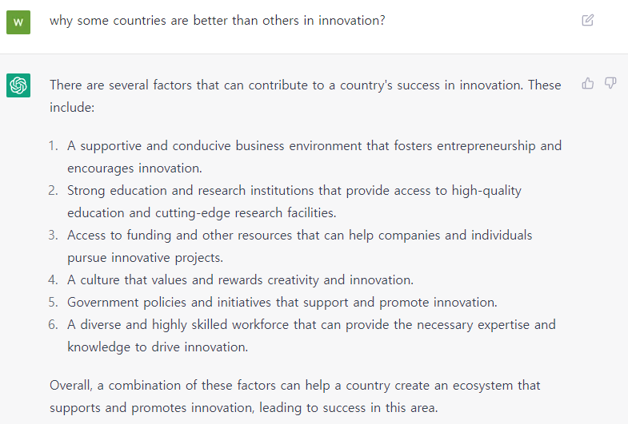
Opening Question
Cardwell’s Law
Answered by ChatGPT
https://chat.openai.com/chat

Slide 4

1. Cardwell’s Law
Cardwell’s Law
Donald Cardwell (1970s)
British historian, set out to identify the main turning points in the history of western technology.
Surveyed over a years of developments in science and technology, cataloging what many consider to be the most important discoveries and inventions in human history.
Simple observation: Nationality should not matter
Donald Cardwell
(1919 – 1998)
“No nation has been very creative for more than an historically short
period. Fortunately as each leader has flagged there has always been, up
to now, a nation or nations to take over the torch.” – Donald Cardwell (British historian)

Slide 5
1. Cardwell’s Law
Cardwell’s Law
National disparities in innovation
How easy it has become to innovate
Globalization: Capital, equipment worldwide
Transportation: People can move with low cost
Communication: Scientific knowledge and technical information are easier to transmit internationally
Then, why are some countries better than others at science and technology?
Why some countries succeed at S&T while others fail
Why national S&T success tends not to last long
→ National leadership in science and technology

Slide 6
2-0. Cardwell’s Law in Action
Cardwell’s Law
S&T had fairly low priorities throughout most of human history
The connection between science and technology was not broadly recognized before the late nineteenth century
Modern economic thought: practically define new science and technology
Most societies realize that S&T can vastly improve their standards of living, economic competitiveness, and physical security
Most government felt that they had little duty or ability to promote innovation
S&T progress is a random occurrence, a product of luck, not policy
National interests
After WWII, gov have come to believed they can, and should do something positive about national innovation rates.

Slide 7
2-0. What needs explaining?
Cardwell’s Law
Technologically disparity countries
Consumption than production
Many countries can afford to buy cutting-edge S&T, but they cannot create it
Factories that produce exports or often set up and run by foreigner.
National innovation rate, look at S&T creation instead of consumption
National patent data

Slide 8
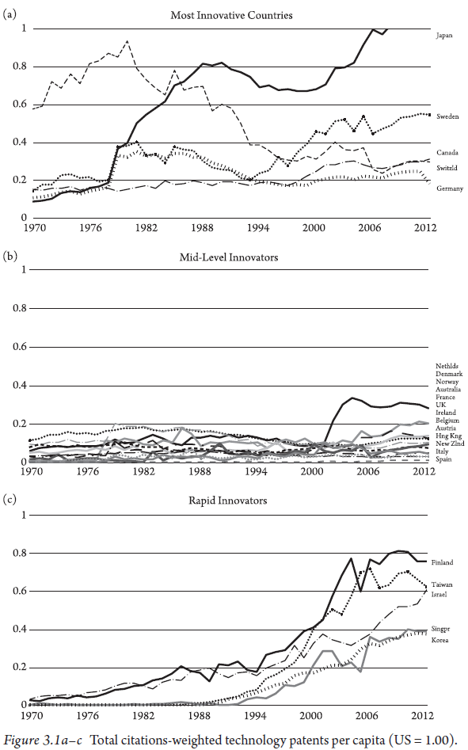
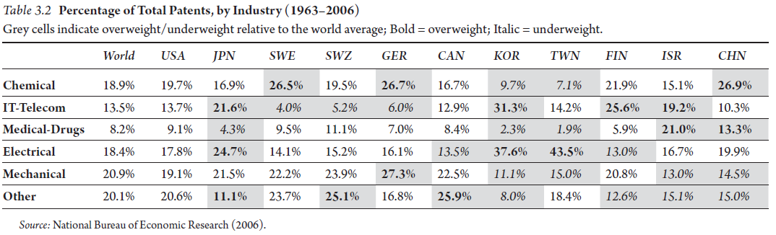
2-1. Innovation Index
Cardwell’s Law
Index: Patent
National patent data
patent somehow reflect specific industries
Patent data rate depends on industrial sector
Normalized by US index (US = 1)

Slide 9
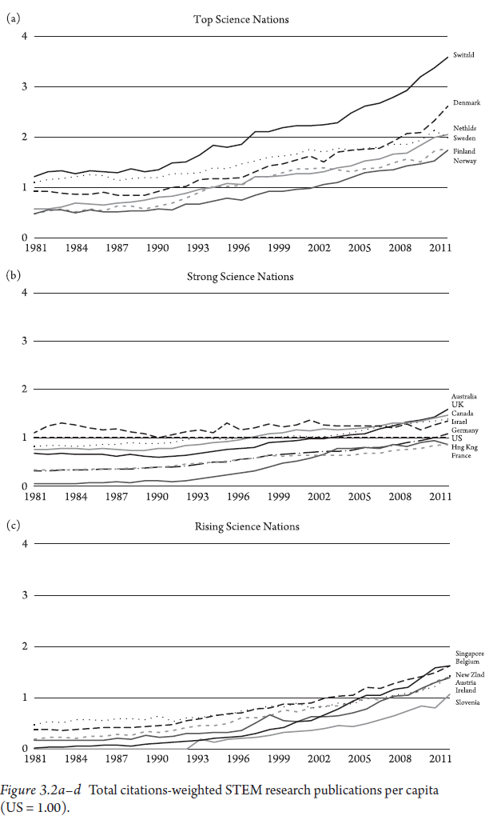
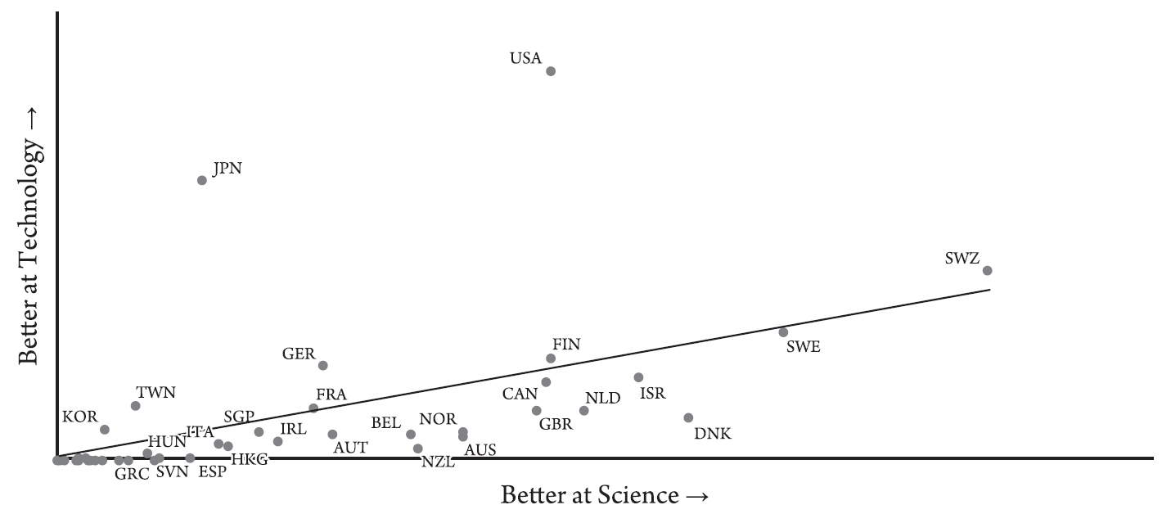
2-1. Innovation Index
Cardwell’s Law
Index: STEM research publication
Scientific knowledge is regularly used as an input to the innovation process.
STEM research publication rates
Scientific progress and technological innovation overlap, but the former does not necessarily lead to latter.
Tech(patents per capita) vs Science(STEM research publications per capita) for 1981-2011
Normalized by US index (US = 1)

Slide 10
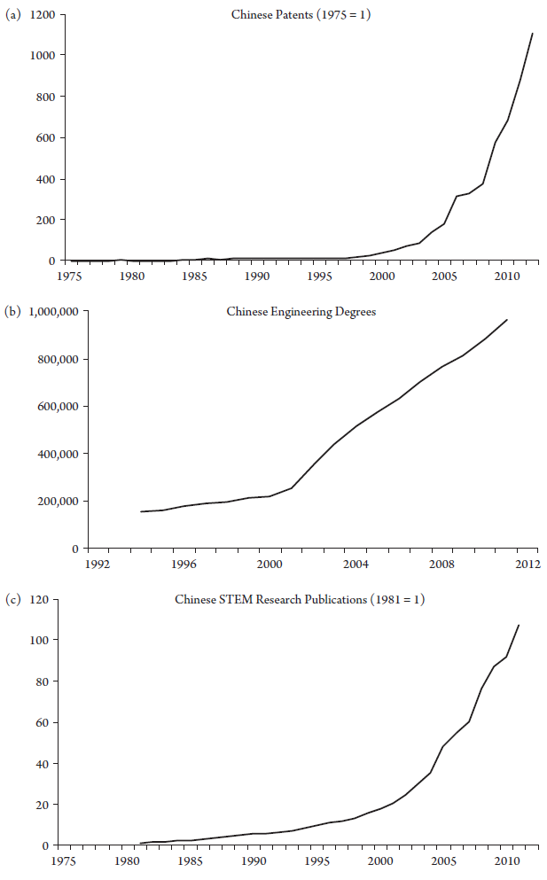
2-2. Case of China
Cardwell’s Law
Index: Patent, Researchers, STEM Paper
China has dramatically improved S&T capabilities, but it still remains a minor player relative to the world's most innovative nations.
Patent
Concentrated on sectors that accept lower standards, less expensive and faster
Papers
China generally lacks the ability to do big science or organize large scale research projects
STEM workers have far less funding and equipment.
Middle Kingdom - outside of Beijing or Shanghai.

Slide 11
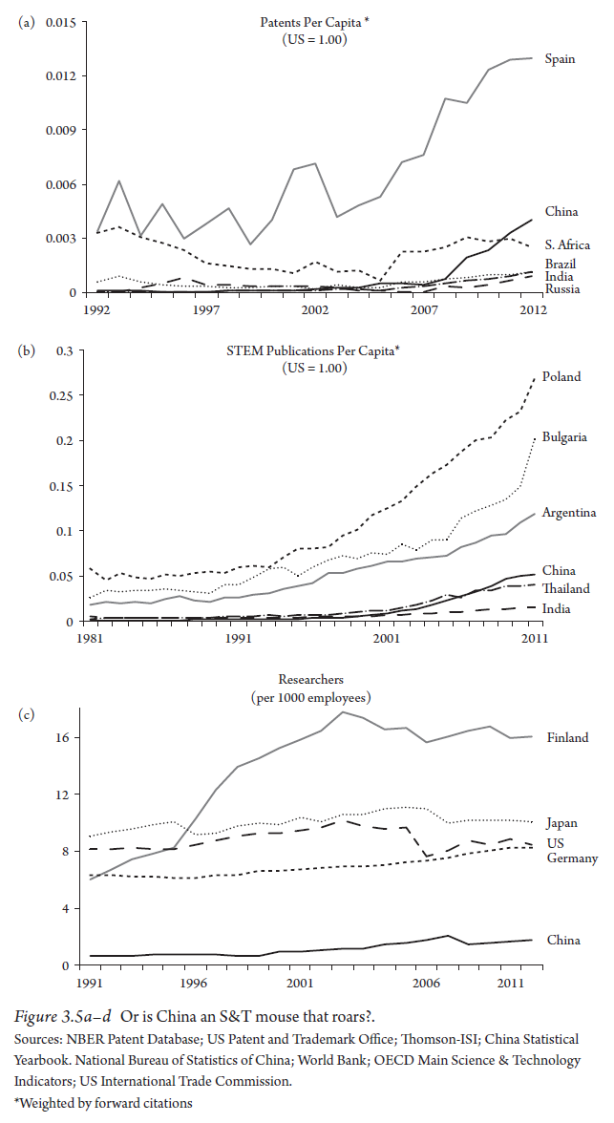
2-2. Case of China
Cardwell’s Law
Index: Patent, Engineers, STEM Paper
Is China the most innovative country?
Do not invent breakthrough technologies themselves. create workshops for manufacturing other countries innovations.
low cost knock offs of foreign products
Short term, low-risk improvements to production or distribution processes, or incremental improvements to foreign products
Fantastic economic growth, but no cutting-edge S&T.
Similar arguments can be presented for - Russia, India, Brazil, South Africa
Occasionally win attention from the media as "Next miracle economy" but actually produce little in S&T
Notes:
Many of Apple’s most innovative products have been manufactured in china.
Please mind these data are from 2010s.
China is one of the leading company in drone, AI sector.

Slide 12
2-3. Methodology to observe the variation
Cardwell’s Law
Other indexes
TEP(Total factor productivity)
Exports of tech
INSEAD index
WEF(World Economic Forum) index
Florida index
Limitations: Private firms often do not publish their scientific research. The scientific output would not show up in the data that tracks research published in peer-reviewed scientific journals.
Corporate science is kept in house, as trade secrets, distributed internally or sold on private markets.
Military and defense contractors would also tend to remain unpublished.

Slide 13
2-4. What needs explaining?
Cardwell’s Law
Cardwell’s law
How and why of national innovation rates differ?
Roles of Government
If a nation wants to improve its S&T performance, then its government must act to solve both market failure and network failures.
Institutions, policies, and networks explain how nations innovate, but not why.
Governments fix markets and create networks
Why do some governments create and support markets and networks for S&T better than others?
e.g) Stronger intellectual property rights, R&D spending, the establishment of universities, advancement of education, strategic trade initiatives to foster national S&T competitiveness

Slide 14
2-5. Explanation of National Innovation Rates
Cardwell’s Law
Explanation of Cardwell’s Law
The rate and direction of scientific progress and technological change are the products of random changce
“Easter egg” or “heroic model” of innovation
But, National innovation rates are not dominated by random chance, at least not on the time scale shown.
If innovation was mostly a random phenomenon, then we would expect to see very different sets of rankings each year.
Only a few countries have experience d drastic changes in their S&T performance over the past seventy years.

Slide 15
2-5. Explanation of National Innovation Rates
Cardwell’s Law
1. Country’s population or economy will determine its national innovation rate
Larger populations can provide more STEM workers and entrepreneurs, and more innovation.
Larger economies have more resources to dedicate toward S&T, exploit for profits and world market share.
But, China, India, Indonesia, Russia, Pakistan, Mexico should be among the world’s best innovators.
2. Military spending determines national innovation rates
Defense-related innovation consistently spills over into the civilian economy
But, S&T progress has flowed in reverse, from civilian to military from some countries in during Cold War period
Neither military spending nor weapons production correlates well with national innovation rates

Slide 16
2-5. Explanation of National Innovation Rates
Cardwell’s Law
3. First-mover advantages on some countries while others locking in competition.
Education system with STEM workforce, S&T based industries make easier to maintain tech frontier.
But, contradicted by late innovators (e.g. Japan, Taiwan…)
4. Late industrialization explains national innovation rates
Late-comers have strong incentives to leap ahead to tech frontier.
Strong interventionist government to allocate resources for catch-up (free-riding concept)
But, how could USA persist as a lead innovator?
5. National culture matters
Risks, rewards, opportunities that guide economic activity, level of trust in a society …
Sometimes society resists to innovate

Slide 17
Ch7. Technological Losers and
Political Resistance to Innovation

Slide 18
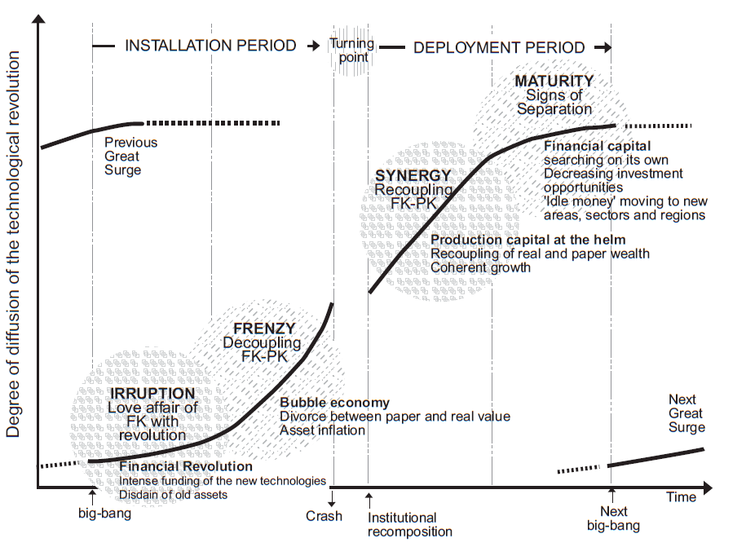
3-1. Political Resistance
Technological Losers and Political Resistance
“Creative destruction” – Joseph Schumpeter’s insights into innovation
The killing off of the old by the new
Innovation may benefit society, but it has its victims, and these victims fight back
Political resistance to new S&T throws a wrench into traditional theories of national innovation rates, and can wreck the policies and institutions designed to promote innovation
Primary obstacles to technological progress are the market and network failures
Technological losers
Fight back against Technology, Industry, jobs, and investors

Slide 19
3-2. Losers created by New S&T
Technological Losers and Political Resistance
Economic
Social
Cultural
Political
S&T progress that conflicts with ethical or normative values
Religious or other cultural groups
Holders of assets whose value is decreased by new S&T
Labor, Land owners, environmentalists, consumers, producers of status quo S&T, inventors in status quo S&T
Innovation will alter their ability to access or negatively affect the costs, risks, or benefit of an existing technology
Minorities
Political power or legitimacy is threatened by S&T progress
Elected officials, political parties, bureaucrats, military, interest groups
Notes:
New military technologies can privilege one branch or mission over another, and thereby trigger interservice or intraservice rivalries. Alternating or reducing the danger of combat, new technology can affect the prestige of particular assignments.

Slide 20
3-3. Case of Electricity
Technological Losers and Political Resistance
Thomas Edison(1880)
Market his new electric power stations
Resistance appeared across economic and political spectrum
Technological Losers
Gas industry: 70yr old Monopoly on lightening in most cities and sought to retain it
Municipal government: power was threatened by the ever increasing size and scope of the local electricity monopolies
Consumers: Feared exploitation by monopoly pricing and service
Citizens: Cross-section of people who felt that electrical fires and electrocution posed a serious threat to their lives and property.
Economic
Social
Cultural
Political

Slide 21
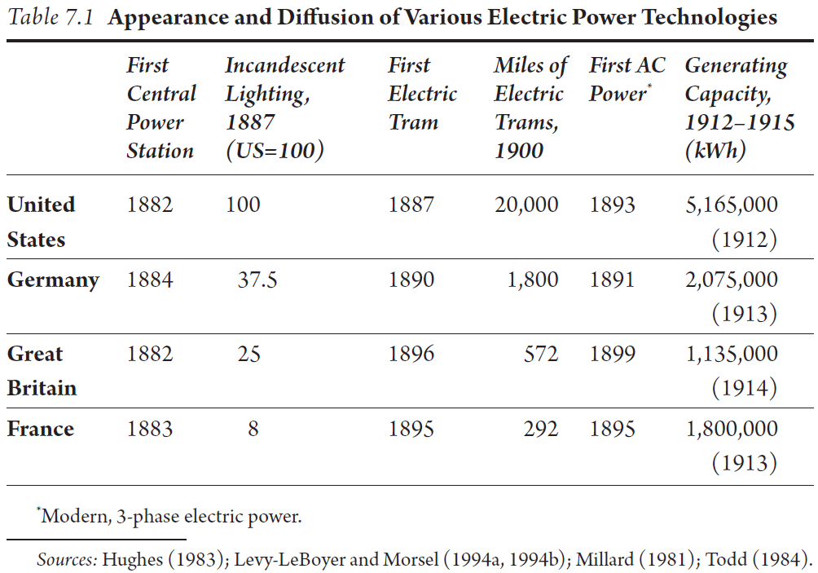
3-3. Case of Electricity
Technological Losers and Political Resistance
The Chorus of Losers
General-purpose technology
Regulations slowed technological change throughout the economy.
Incremental innovations
Face less opposition than radical
New technology need not to be a revolutionary

Slide 22
3-4. The Chorus of Losers
Technological Losers and Political Resistance
Distributive aspects of innovation
Revolutionary S&T can be fought so successfully for so long, while some incremental innovations are able to proceed more rapidly.
Revolutionary: entire industries, workers, economic vitality of the regions
Incremental: only a single firm’s product line, decrease its profit.
Political elites are pressured by much larger interest groups seeking protection
General taxes, regulations, the removal of government support for new tech, protection and procurement for status quo tech
→ Political representative’s constituency

Slide 23

3-4. The Chorus of Losers
Technological Losers and Political Resistance
The higher the cost of discarding an existing tech, the more resistant and less supportive to innovations
cf) Developer: Highly innovative culture, technology rapidly changes
Immobile Assets
Tightly linked to Technology
(e.g. Nuclear engineers)
Firms of status quo technology
Mobile Assets
Highly liquid(stocks and bonds)
Unaffected by technological change (accounting skills, physics degree)
Uncommitted(cash, college entrants)
More Resistant
More Supportive
Reference: https://github.com/tvandame/back-end-developer-interview-questions/blob/master/Translations/Korean/README_KR.md

Slide 24

4-0. Military resistance to Innovation
Military cases
Resistance to technology that might replace them can be quite intense in military
Changes to long-established strategic doctrines, battlefield tactics, or bureaucratic organizations
Military advancement
Altering or reducing the dangers of combat, new technology can affect the prestige of particular assignments.
Civilians can also slow military innovations.
Budget allocation, myriad organizational and political forces, provocative anti-war
e.g) ship construction, munitions acquisition, Tomahawk cruise missiles
Tomahawk cruise missiles
Delayed 30 yrs
Tomahawk cruise missile, launches from ships and submarines,
Manufactured by Ratheon
Notes:
New military technologies can privilege one branch or mission over another, and thereby trigger interservice or intra service rivalries. Alternating or reducing the danger of combat, new technology can affect the prestige of particular assignments.

Slide 25


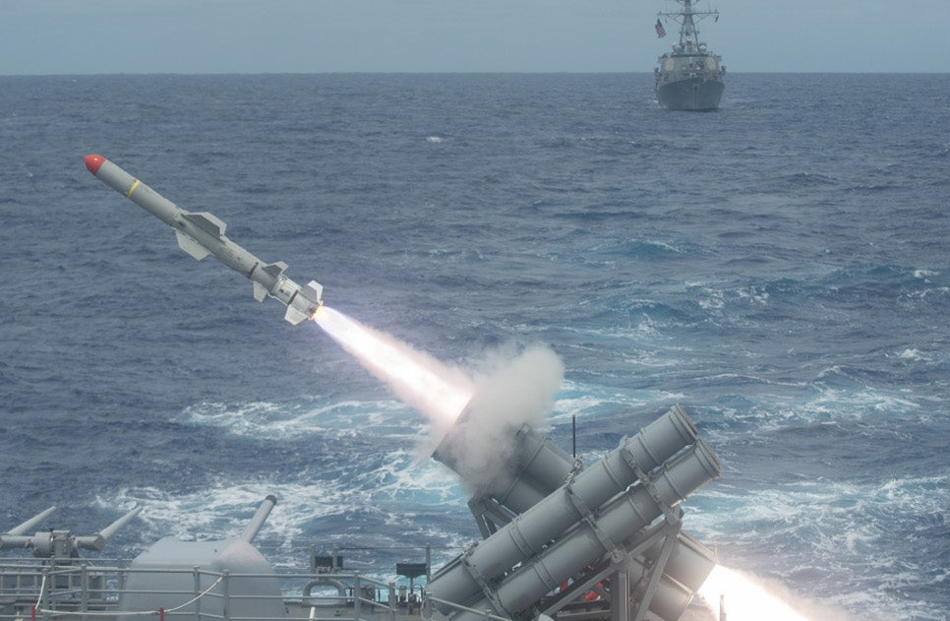
4-1. Case of Naval Missile
Military cases
Oppose from Aircraft community within Navy(1960s)
Pilots claimed manned aircraft fulfilled missions more efficiently
Harpoon antiship missile, possessed limited range (1977)
P-3 Orion Patrol Aircraft
armed Harpoon missiles
ATM-85 Harpoon antiship missile on A-4 Skyhawk
Harpoon antiship missile, launched from ship
Tomahawk cruise missile
Naval commanders continued to resist the weapon’s installation (1983)
Lack of control on new over-the-horizon missile, not able to recalled nor targeted by sight
→ Request of Trustworthy

Slide 26



4-2. Military standardization & qualification
Military cases
Trustworthiness of standardization & qualification
MIL-STD-XXXX

Slide 27
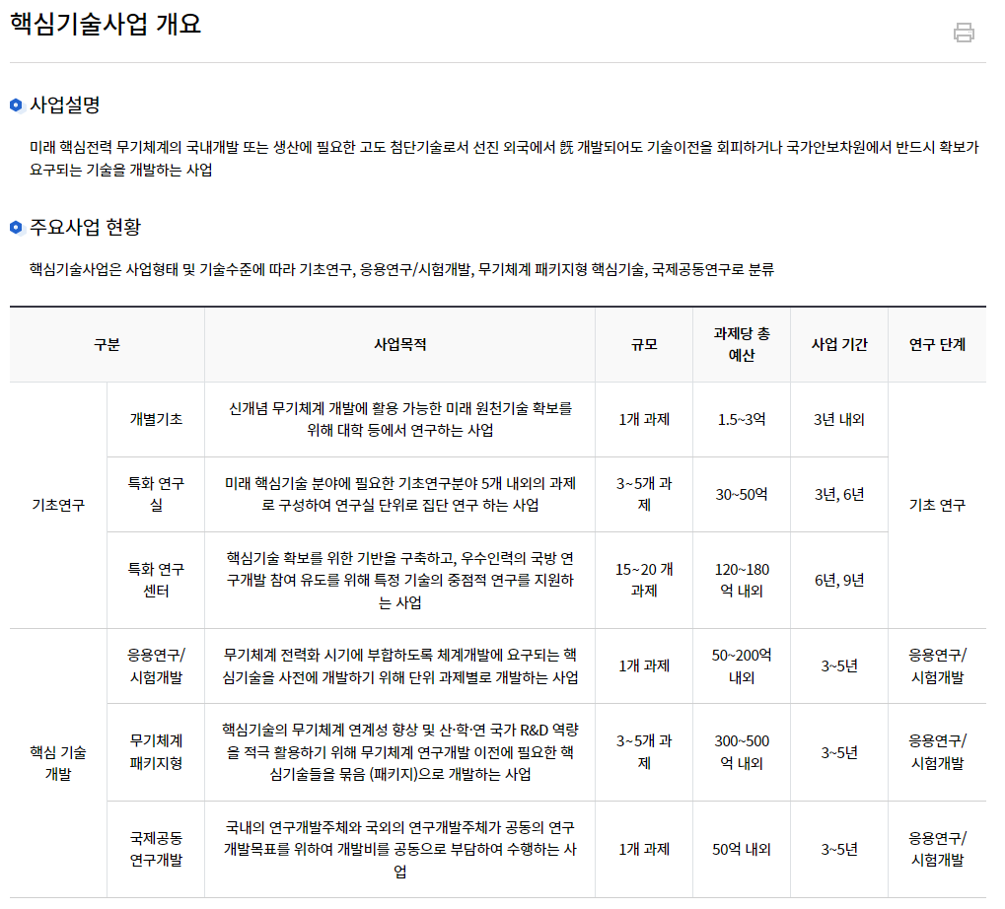

4-3. Meanwhile, in Korea
Military cases
Government as a innovation initiative is ongoing project on military systems
국방기술진흥연구소, krit.re.kr

Slide 28
5. Conclusion
Technological Losers and Political Resistance
S&T progress creates winners and losers, and the losers can resort to politics to obstruct innovations that threaten their interests.
Government is rarely a neutral observer in these upheavals but rather is pursued by both sides in the hope of gaining policy advantages in their mortal conflict
Political opposition to the “creative destruction” aspects of innovation helps to explain why some countries are better at S&T than others.
Political opposition lowers the incentives to innovate
“Every innovation is born into an uncongenial society, has few friends and many enemies, and only the hardiest and luckiest survive” – Cyril Smith, historian

